Slide 1
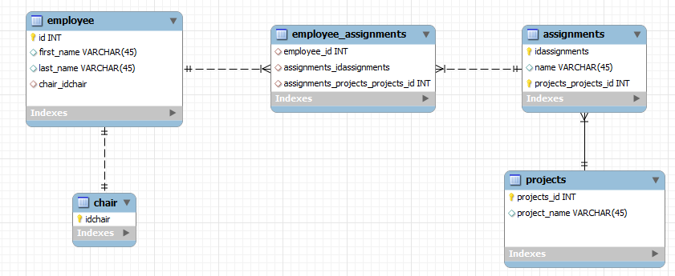
The Data Model

Slide 2
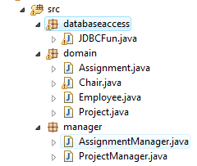
Project Structure

Slide 3
domain
Assignment
Project
manager
AssignmentManager
ProjectManager
dbaccess
JDBCFun

Slide 4
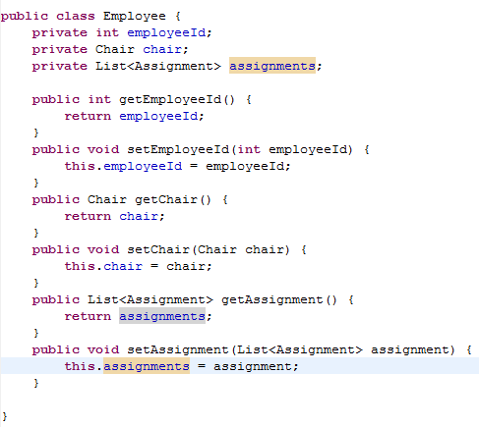
The Employee Class

Slide 5
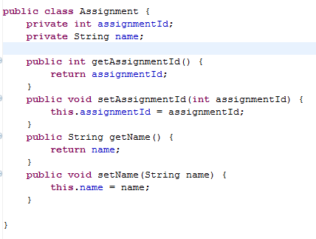
The Assignment Class

Slide 6
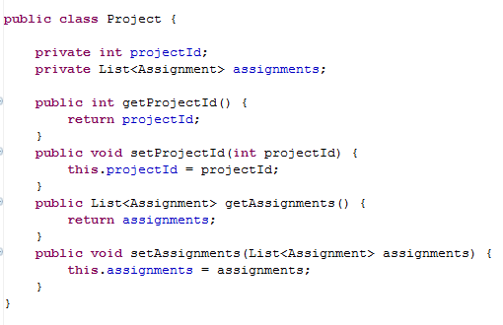
The Projects Class

Slide 7
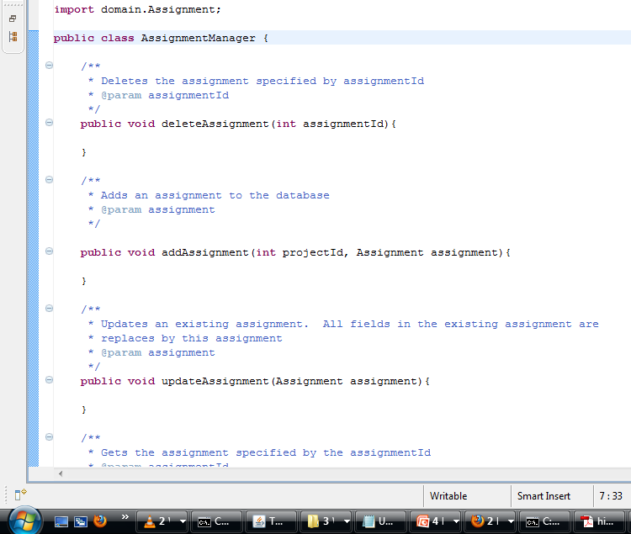

Slide 8
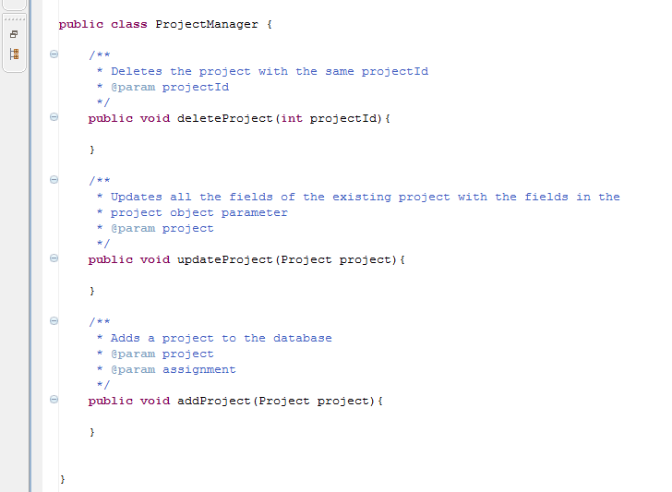

Slide 9
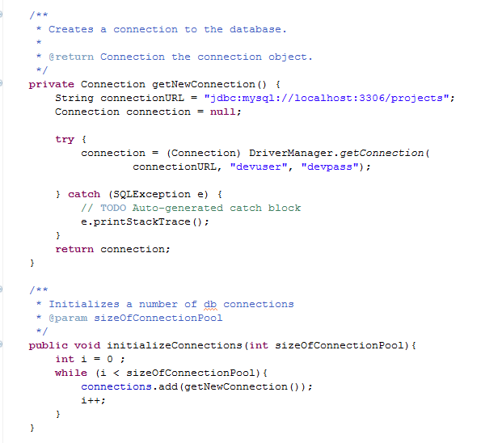
Managing database connections

Slide 10
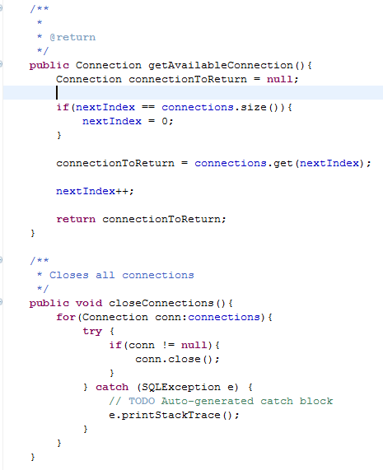
Managing database connections

Slide 11
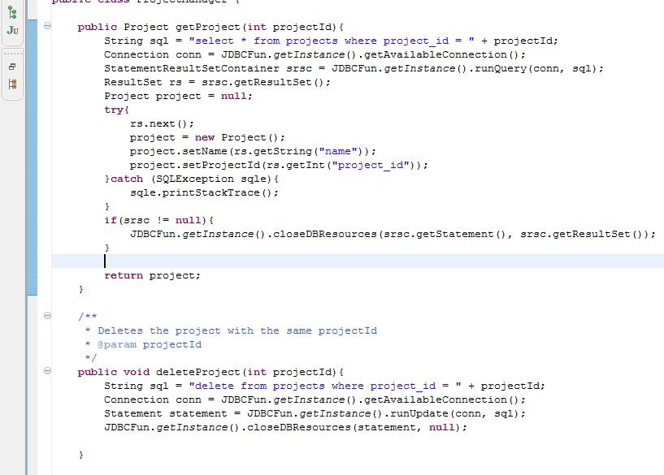
Manager implementation

Slide 12
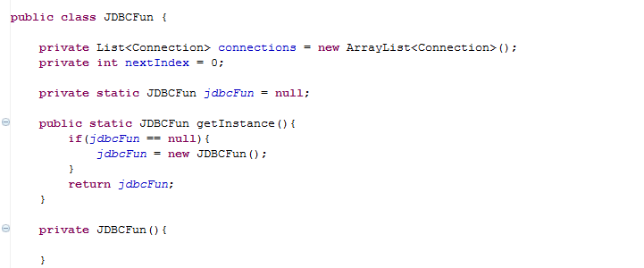
JDBC Sinlgeton

